Slide 1
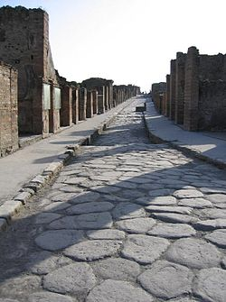
Macro Factors Where the Fleet Management Business will be in 2020 Michael L. Sena President Michael L. Sena Consulting AB 13 March 2014

Slide 2
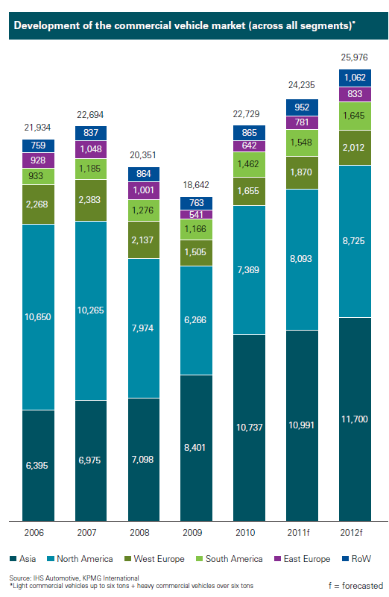
Bad Years
Not like it used to be
Go East!

Slide 3
Live
This chart shows where the buying power will be in the next thirty or so years.
In 2050, six of the top ten countries in population will be Asian, but Japan and will not be among them and China will no longer be first. Africa is rising, with Nigeria passing the United States for third place and Ethiopia making the list.
Europe disappears from the top ten after 2013 when Russia, Germany, Italy and the United Kingdom retreat. South America is marginalized.
One school of thought holds that Europe, with most countries having many fewer people with a higher average age, will stagnate economically. Another school says that the new 60 is 70 and that more experienced workers will deliver higher productivity gains. Smaller may be better.

Slide 4
Countries: Where we will live
1950
2013
2050 forecast
2.5
Global population, billions
7.2
Total World Population 9.6
The ten most populous countries, billions of people
0 1 3
0 1 3
0 1 3
1
China
China
India
2
India
India
China
3
United States
United States
Nigeria
4
Russia*
Indonesia
United States
5
Japan
Brazil
Indonesia
6
Indonesia
Pakistan
Pakistan
7
Germany
Nigeria
Brazil
8
Brazil
Bangladesh
Bangladesh
9
Britain
Russia
Ethiopia
10
Italy
Japan
Philippines
Source: United Nations
*Then part of the Soviet Union
USSR Population 1991: 283 million
US Population 1991: 253 million
Asia
North America
Europe
Latin America
Africa

Slide 5
Macro Factors
Where the Fleet Management business is today is a result of four major converging technologies that were commercialized simultaneously in the 1990s, like a Big Bang:
Wireless telecommunications technologies
Digital maps
Global navigation satellite systems
The Internet
All of these technologies had their roots in political, social and economic events that existed in a post-World War II Cold War context. Whether we like to be reminded about it or not, they were funded and initially developed principally for securing military advantage.
They were commercialized and have been used to create all types of products that are affecting our daily lives and having an impact on our individual and collective futures.

Slide 6
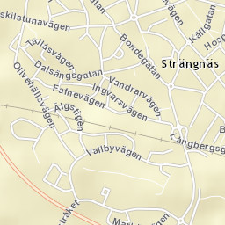
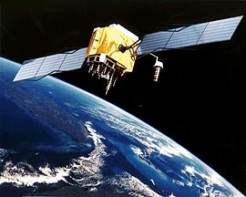
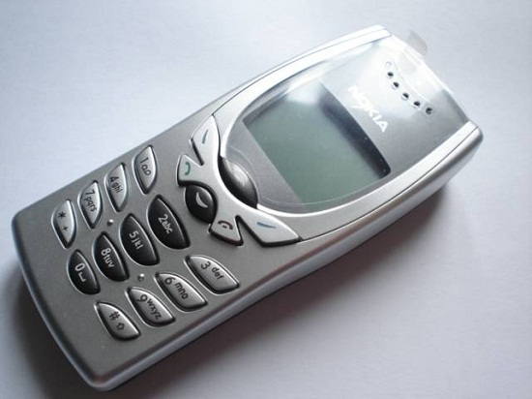
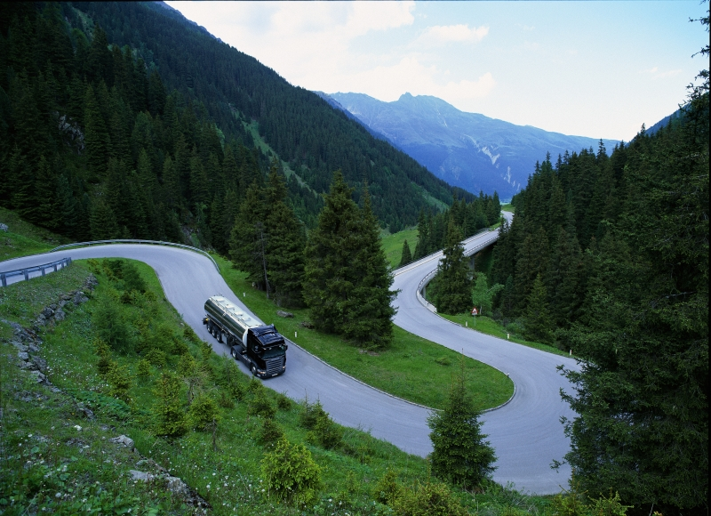
Macro Factors
GNSS
Digital Maps
Wireless Technologies
Big Bang
Internet

Slide 7
Macro Factors
Where will the Fleet Management business will be in 2020? In six years, between now and 2020, much can change. An example of just how quickly things can change is the impact that the iPhone has had.
Steve Jobs introduced the iPhone, in his own words, “…as a wide-screen iPod with touch screen controls and a full-function smart phone with Internet connectivity.” The first iPhones were delivered to consumers in June 2007.
In seven years, this invention changed almost everything. The iPad followed. Jobs presented it in January 2010. Whatever hadn’t changed by then changed afterwards.
But none of Apple’s or Google’s or Amazon’s inventions, or the fuel-saving and safety-improving inventions of the vehicle manufacturers, exist inside their own bubbles. They are both affected by and affect developments in how we live on and use this planet earth.
These are the Macro Factors.
Amazon didn’t start because of the Internet. It started because people got too far away from their bookstores.

Slide 8
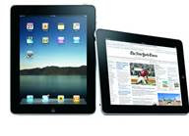
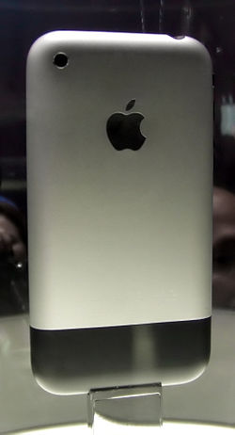
iPad Presented in April 2010
First iPod sold November 2001
+
=
First iPhone sold
June 29, 2007
Internet

Slide 9
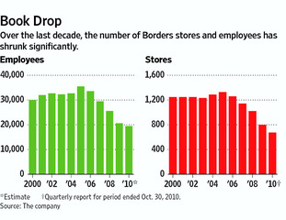
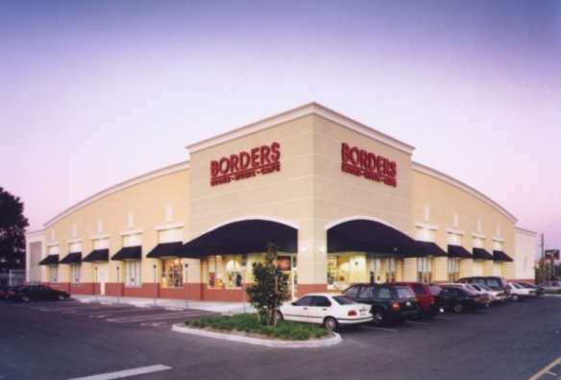
The beginning of strip mall book stores
1971 Borders
founded
Number of book stores within walking distance of home or work
1995 Amazon
launched
2011 Borders
bankrupt
1971
1995
2011
Amazon did not cause the problem; it exploited it.

Slide 10
Macro Factors are the events that really make the world spin. They are the political, social and economic activities that cause countries and regions to experience growth or contraction, that cause population increases and decreases and massive movements of people from one region to another.
Think of the Great Plague, the Great Depression, the two World Wars, the fall of the Iron Curtain and, more recently, the Great Recession. Europe continues to experience economic, political and social unrest as a result of this event.
Our businesses do not exist in a vacuum. Fleet management is no exception. The more vehicles that are sold, the greater are the chances that the fleet management pie will grow. The opposite is also true. Vehicle sales are the result of how well or how poorly societies are functioning. Vehicle sales in the US and Europe collapsed in 2009 and China sailed by both regions.
The six macro factor questions we need to answer are:
Where and how will we live?
What work will we do and where will we do it?
How and where will we purchase our physical goods?
How will we get from where we are to where we want to be?
How will our goods get from where they are produced to where they are consumed?
And how will the answers to all of these questions affect both the short- and long-term profitability or the very existence of our businesses.

Slide 11
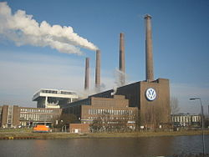
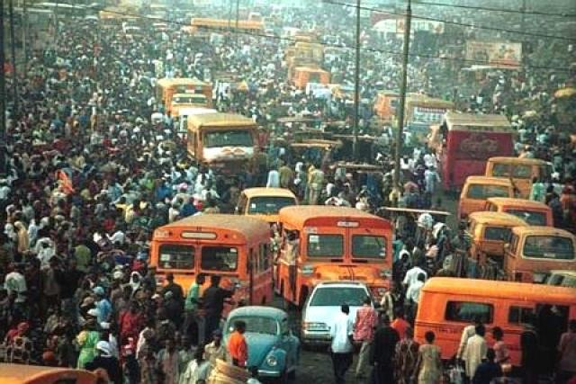
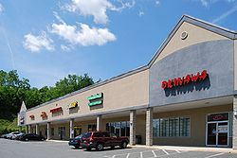
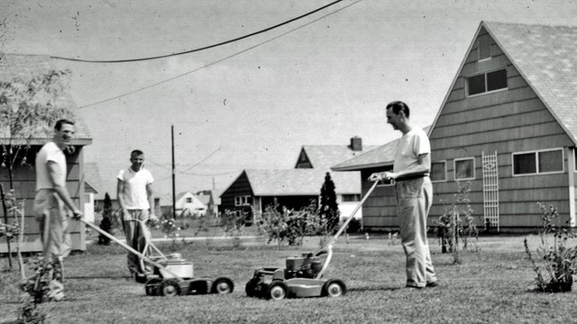
Move
Work
Shop
Live

Slide 12
Live

Slide 13
Where we lived
In North America and Western Europe, industrialization created a mass movement from the rural countryside to the cities in the 18th and 19th centuries.
In the second half of the 20th century, wars, crime, cars, new ways of communicating and many other factors combined to move people from cities to suburbs. A suburb, for statistical purposes, is any place in a metropolitan area outside the central city. By 1951, more people in the United States lived in suburbs rather than in central cities or rural areas.
Now, it seems that the trend is reversing. More and more people in what we have called the emerging markets are moving from the countryside to the city. Baby boomers in what we have called the developed countries are giving up their suburban estates and Weber grills for urban condos and dinners delivered to the door

Slide 14
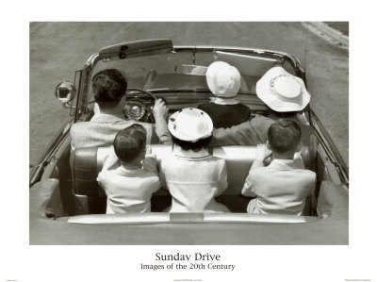
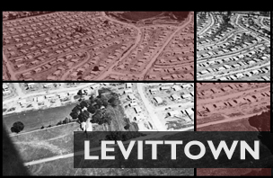
Where we lived
Suburbia

Slide 15
Where we will live
In 1800, according to estimates made by the UN, only 3 percent of the world's population lived in cities. Today, more than half the world's population lives in urban areas, and by 2050 the UN estimates that will be more like 67 percent. In developed countries, that percentage will be higher.
Large US cities, defined here as those with 150,000 or more inhabitants, generated almost 85 percent of the country’s GDP in 2010, compared with 78 percent for large cities in China and just under 65 percent for those in Western Europe during the same period.
In the next 15 years, the 259 large US cities are expected to generate more than 10 percent of global GDP growth—a share bigger than that of all such cities in other developed countries combined.

Slide 16
Mega Cities: Where we will live
1970
1990
2011
2025
% Total World
Population
1 %
1,5 %
5 %
8 %
Total # Cities
2
10
23
37
The most populous urban agglomerations with 10 million or more inhabitants
0 25 50
0 25 50
0 25 50
0 25 50
1
Tokyo
Tokyo
Tokyo
Tokyo
1
2
New York/
Newark
New York/
Newark
Delhi
Delhi
2
3
Mexico City
New York/
Newark
Shanghai
3
4
São Paulo
Mexico City
Mumbai
4
5
Mumbai
Shanghai
Mexico City
5
6
Osaka/Kobe
São Paulo
New York/
Newark
6
7
Calcutta
Mumbai
São Paulo
7
8
Los Angeles
Beijing
Dhaka
8
9
Seoul
Dhaka
Beijing
9
10
Buenes Aires
Calcutta
Karachi
10
11
Karachi
Lagos
11
Source: United Nations
Asia
North America
Europe
Latin America
Africa

Slide 17
Live – Implications for Fleet Management
Anyone who has attempted to move by motorized vehicle from one side of Shanghai—or any large city—to the other during almost any time of day will understand that it is no longer the last mile that is the problem. It can take as long to move a truck from its urban entry point to its destination as it does to drive from the logistics center in the countryside to the city.
The sprawling logistics centers in the middle of the countryside will be replaced with many smaller ones closer to where we live, and that will be in larger and more densely packed cities.
Once in the cities, goods will need to move at times when most people are not working or using the roadways, and cities will need to build special infrastructure to ensure that all goods and necessary services are free to move unhindered by transport moving people.

Slide 18
Live – Implications for Fleet Management
Groupware, virtual private networks, conference calling, videoconferencing, and Voice over IP (VOIP) are making it possible for people to stay where they are and still communicate with co-workers. It can be efficient and useful for companies since it allows workers to communicate over long distances, saving significant amounts of travel time and cost.
As broadband Internet connections become more commonplace, more and more workers have adequate bandwidth at home to use these tools to link their home to their corporate intranet and internal phone networks.
All signs point to knowledge workers working closer to where they live. But will that be on isolated hilltops in the Apenines or in a condominium in the middle of any one of the twenty-five super cities with more than 10 million that will exist in 2020?

Slide 19
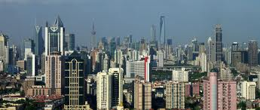
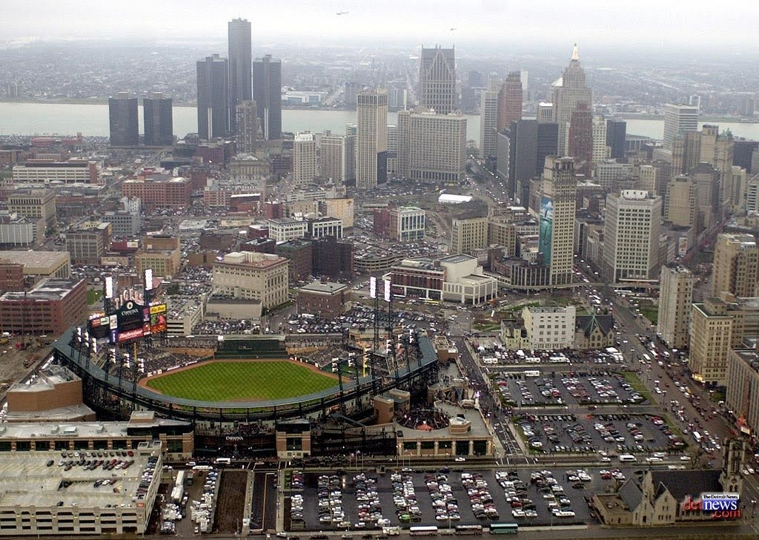
Where we will live
Detroit
Shanghai

Slide 20
Work

Slide 21
Work
In the past fifty years, what was known as the industrialized West and now is just Europe and North America, has lost its manufacturing base, mostly to Asia. Manufacturing in these regions has been replaced by a combination of services and higher unemployment.
Service operations are different from manufacturing operations in terms of tangible versus intangible output, customer consumption, use of labour and equipment, customer contact, customer participation in conversion processes.
Manufacturing is characterized by tangible output, outputs that a consumer consumes over time, like a vacuum cleaner. Service is characterized by intangible outputs, outputs that customers consume immediately, like a hamburger.
Fifty years ago, twelve of the fifteen largest US companies were involved in the production of tangible output. Today only three of the top fifteen US companies are goods producers, and only one of them from 1960 is among the top 15.

Slide 22
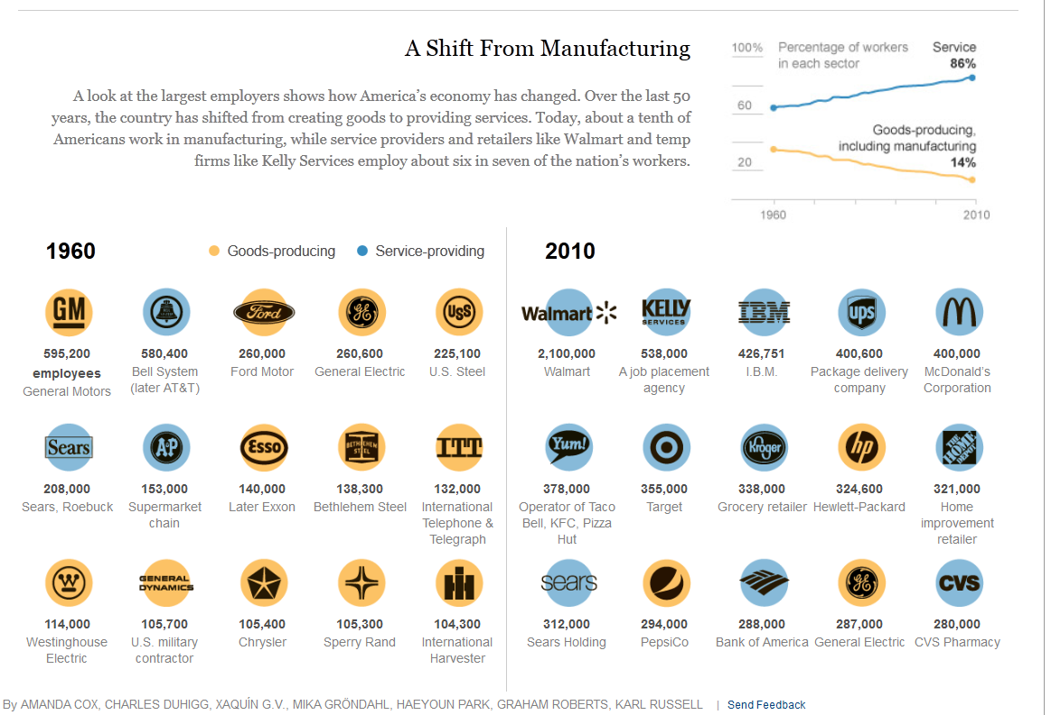
Where we worked
Number of Employees in US Companies

Slide 23
Where we worked
Automation of manufacturing operations was the result of the need to modify finished goods inventory levels in response to many factors: changes in customer demand patterns; economic fluctuations; and availability of labour and natural resources. It is easier to reprogram machines than to retrain people.
In services, the most expensive resource is people, while in manufacturing the most expensive resource is machinery and the facilities to house the machinery.
Services are off-shored in order to reduce the hourly costs of labour. Manufacturing is off-shored in order to substitute inexpensive manual labour for expensive manual labour and expensive automation.
As off-shore costs for manual labour rise, as has been the case, the advantages of off-shoring both services and manufacturing disappear.

Slide 24
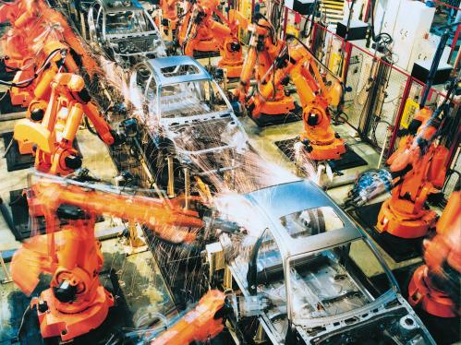
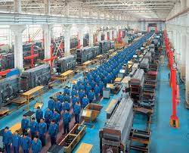
Work

Slide 25
Where we will work
Services and manufacturing are re-shoring in Europe and North America at the same time as domestic companies expand their own investments in Asia, in Africa and in South America.
This does not mean that more jobs will be available in manufacturing in Europe and North America since goods production has become highly automated. Service job formation is dependent on new company creation, which are increasingly dependent on government policies.
Eight of the world’s top ten employers are government agencies or 100% government-owned companies. The US Department of Defense is the world’s largest employer, with the Chinese People’s Liberation Army in second place. The only private companies on the top ten list are Walmart and McDonald’s.
The dominance of government employment on one side and the expansion of low-paid counter staff jobs will not change in the near to mid-term future
The rankings in the chart are from the Fortune Global 500 and do not include non-corporate public employers.
This is the list of top 10 corporate employers in the world as published on 9 July 2012. It is based on the companies' fiscal year ended on or before 31 March 2012.

Slide 26
Work
United States Department of Defense | 3.2 million (2010)
People's Liberation Army | 2.3 million (2008)
2012 Fortune Ranking of World’s Largest Non-government Employers
Rank | Company | Country | 2011 Number of Employees
1 | Walmart | United States | 2,200,000
2 | China National Petroleum Corporation | China | 1,668,072
3 | State Grid Corporation of China | China | 1,583,000
4 | Sinopec | China | 1,021,979
5 | Hon Hai Precision Industry | Taiwan | 961,000
6 | China Post Group | China | 889,307
7 | U.S. Postal Service | United States | 601,601
8 | Volkswagen | Germany | 501,956
9 | China Telecommunications | China | 491,447
10 | Aviation Industry Corp. of China | China | 480,147

Slide 27
Work – Implications for Fleet Management
Service work will increasingly be done from home by solo workers or by small teams in distributed work clusters. These work clusters will be located in cities close to public transportation and at park-and-ride facilities at the edges of cities to make them accessible to the greatest number of individuals.
Manufacturing will be re-shored and be performed in micro factories which are highly automated and widely distributed so they are close to their destination markets—the cities, where most people will live.
Increased development of personal manufacturing tools operated by ‘makers’ will intensify and reduce the distance between producers and consumers.
Result; the goods that people use in their work will be delivered to many smaller places in smaller quantities.

Slide 28
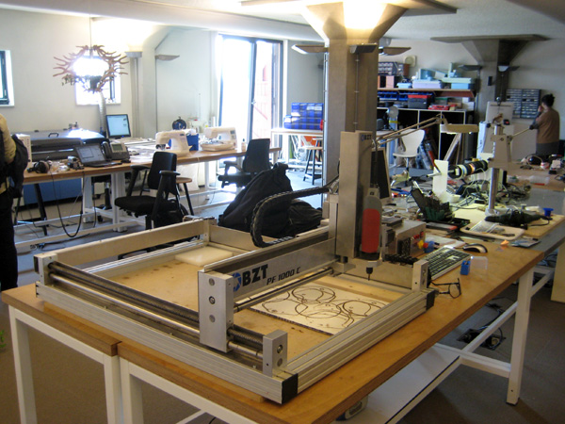
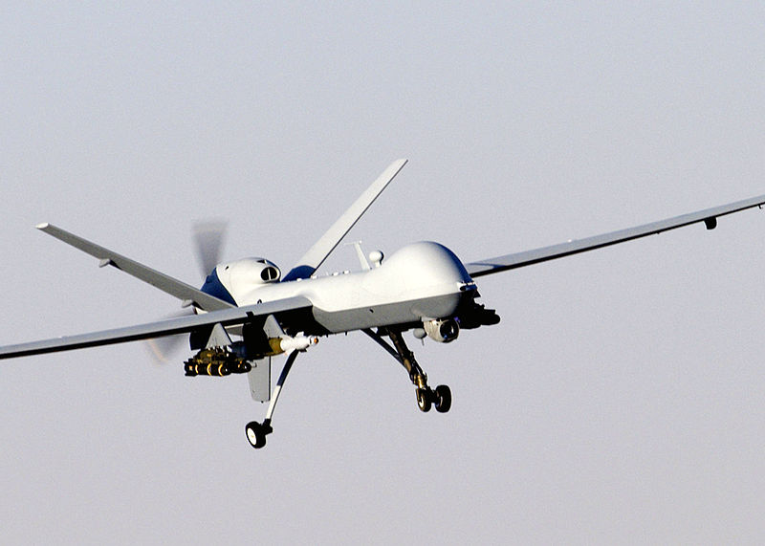
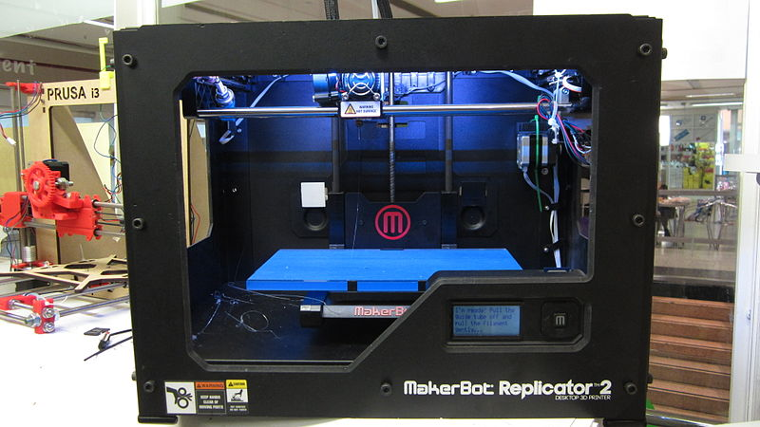
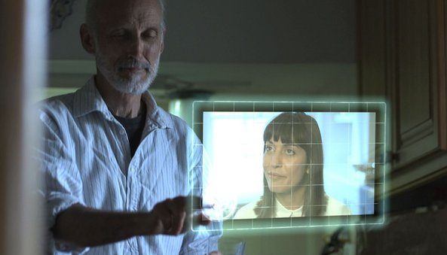
Where we will work
3d printing

Slide 29
Shop

Slide 30
Shop
Up until the second half of the 19th century, the buying of food and everyday provisions was a daily routine, not a form of entertainment. Department stores, such as Lord & Taylor and Macy’s in New York, Le Printemps in Paris, brought goods that had been sold in many different shops into a single location and ‘shopping’ was born.
We still bought most of the things we needed close to home until people began to own their own cars. Then we drove to super markets, to strip malls and finally to the out-of-town shopping centers and giant indoor malls. Small shops in the centers of villages and neighbourhoods closed because they could not compete on prices or variety with the big box stores.

Slide 31
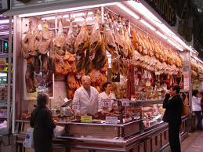
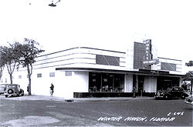
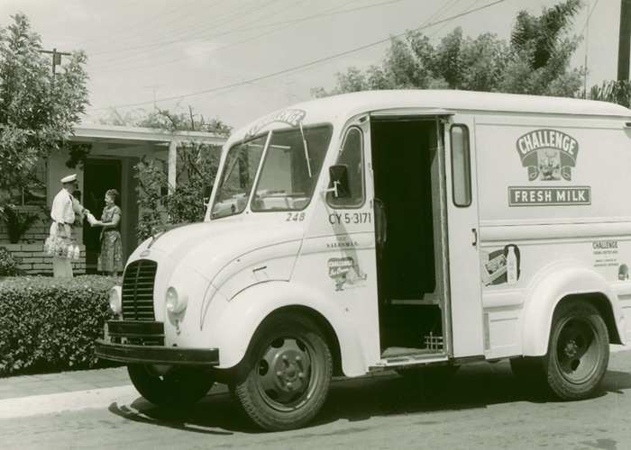
How we purchased our physical goods
Super Market
Delivery Truck
Food Hall
Strip Mall
High Street

Slide 32
Where we have shopped
Big box stores changed where and the way we shopped. We loaded up our cars with provisions for a month, buying in bulk. We needed larger freezers and refrigerators and storage places, which meant we needed larger houses and more cars and more garage space. Change slide.
The Internet is now creating a new paradigm shift in shopping, causing customers to abandon bricks and mortar stores like Blockbuster and Barnes and Noble for online alternatives. The malls are where people try on and try out products; the Internet is where they buy them.
The local store is making a comeback. The first 10 Walmart Express test stores opened last year, and more test stores will open later this year. One-tenth the size of the typical Walmart discount store, these Express stores are a combination of food, pharmacy, and convenience stores -- targeting customers more inclined to visit a smaller bargain store like Dollar General, Family Dollar, or Dollar Tree.

Slide 33
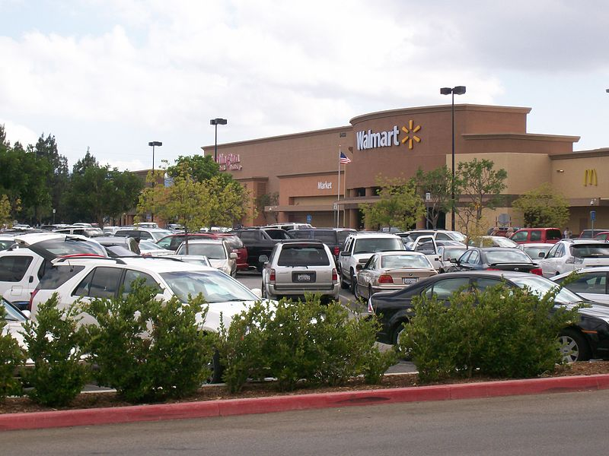
Where we have shopped

Slide 34
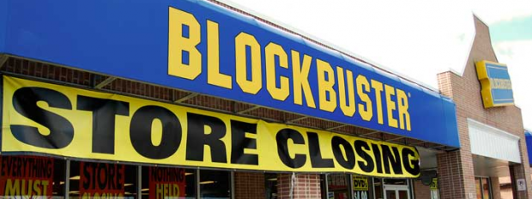
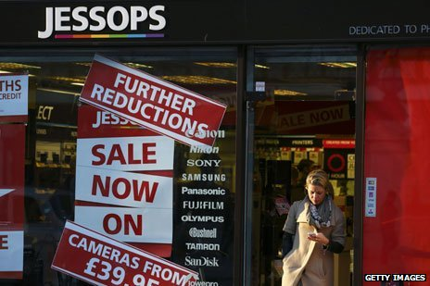
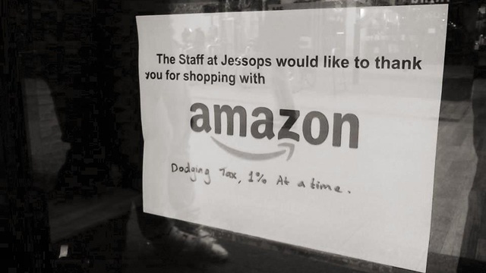

Slide 35
Shop – Implications for Fleet Management
Some have predicted the demise of all forms of physical stores in favour of home delivery for all of our everyday needs, from latte (aka milk) for the coffee and the evening’s dinner to clothes, shoes, medicines, the week’s laundry and dry cleaning.
So, instead of delivering to shopping centers and big box stores, which will gradually disappear, we will deliver to distribution points and then from these points to the door or to community drop points.
We are going to shop closer to home and goods will once again be delivered to our door. The bigger change will be how those products actually get to the door.

Slide 36
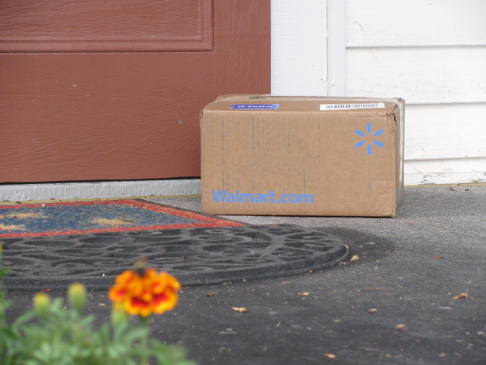
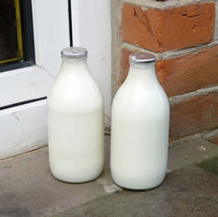
How we will purchase our physical goods

Slide 37
How the goods will get to the door.
Across the United States, Amazon is erecting massive distribution centers in the nation’s exurbs to shorten the distance between online shoppers and the goods they want. They are now committing to a program that will get those goods to consumers in hours rather than days.
“We're excited to share Prime Air — something the team has been working on in our next generation R&D lab. The goal of this new delivery system is to get packages into customers' hands in 30 minutes or less using unmanned aerial vehicles. Putting Prime Air into commercial use will take some number of years as we advance the technology and wait for the necessary FAA rules and regulations.” Jeff Bezos, Amazon CEO

Slide 38
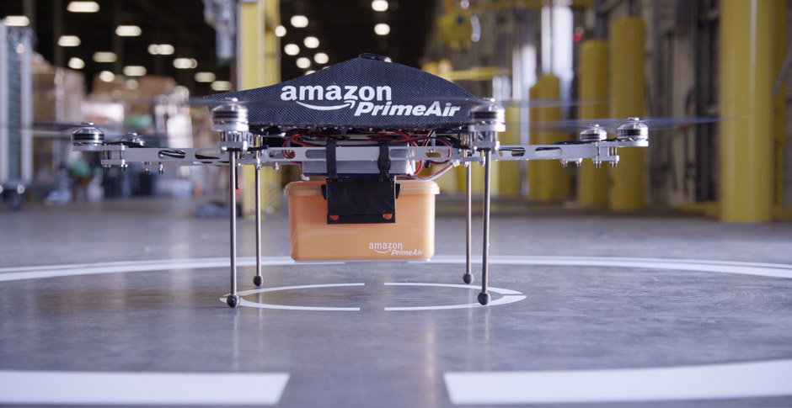
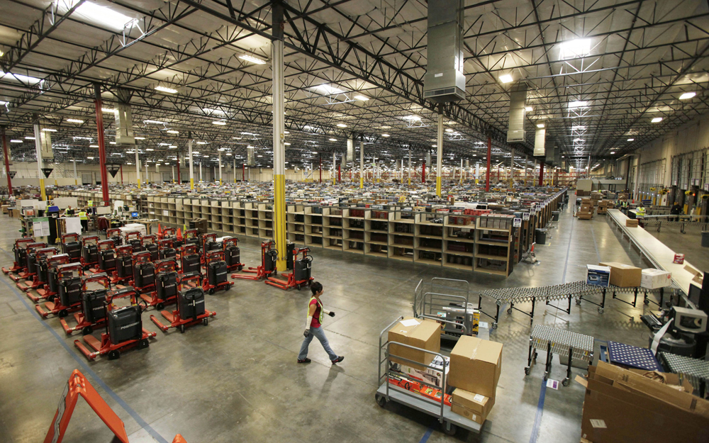

Slide 39
Move

Slide 40
Movement
In the beginning there were two feet and people used them to carry their bodies and things they needed across whatever distances they were forced to travel. Eventually, animals were conscripted into service—without having any say in the matter, it might be noted. Carts of all types were hitched up to these animals.
The self propelling vehicle—trains, buses, trucks and cars—liberated horses, mules and oxen and allowed us to move more goods and people over ever longer distances and at a much faster rate.
Until we reached the limit of sprawl. Then everything changed.

Slide 41
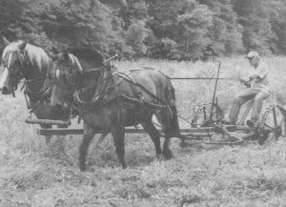
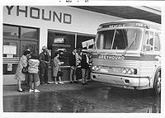
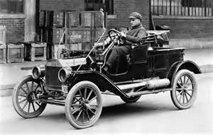
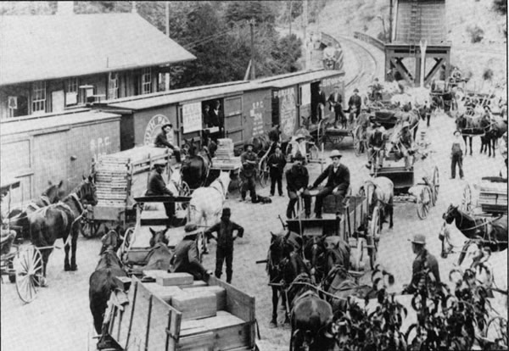
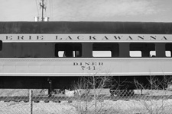
How we moved

Slide 42
How we have moved.
We move ourselves by car and our goods by truck. Passenger cars accounted for 84.1 % of inland passenger transport in the EU-27 in 2010, with buses and coaches (8.8 %) and railways, trams and metros (7.1 %) both accounting for less than a tenth of all traffic (as measured by the number of inland passenger-kilometres (pkm) travelled by each mode).
But congestion has already begun to make other alternatives better options. Those other alternatives include bicycling, walking and public transit.
The average commuter in the US wasted 38 hours during 2012 sitting in traffic. That’s a week he or she could have been skiing or fishing or having fun with family or friends.

Slide 43
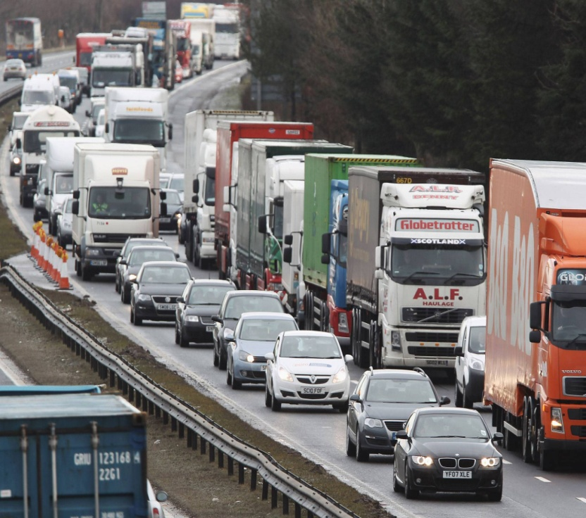
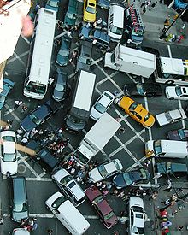
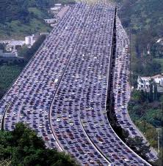
How we move…
or don’t move

Slide 44
How we will move
The car in its present form has had its day because it is not designed for personal urban transport. It takes too much care and feeding. More importantly, it is not designed for boys and girls who grew up being chauffeured and who are not going to take their drivers’ licenses. Cars will need to drive themselves.
Airplanes have been piloting themselves for years. Planes take off, fly and land themselves without the slightest need for the hands of a pilot. Ships crisscross the oceans without a steersman ever touching the helm.
Why not cars and trucks and busses and all types of vehicles that currently run on roads?
Vehicles that fix their own problems;
Vehicles that fuel themselves;
Vehicles that park themselves; and,
Vehicles that drive themselves.

Slide 45
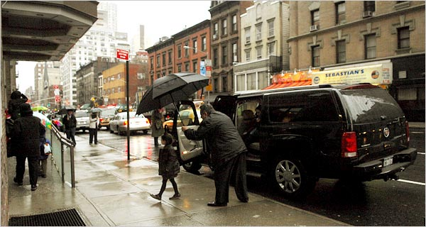
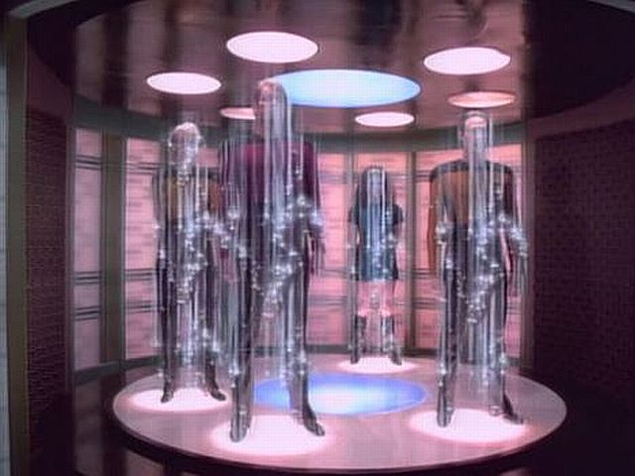
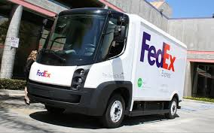
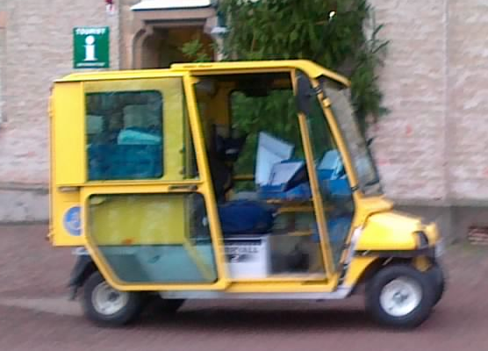
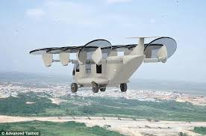
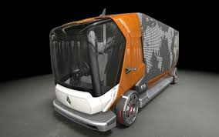
How we will move

Slide 46
Move – Implications for Fleet Management
We are going to put things where it will be easier for self-driving cars and trucks to find them. We could have done that for ourselves, but we invented maps and navigation systems instead. We exploited real estate to maximize the profit for developers, constantly looking for low-priced land further from the city cores. That’s over, at least on this planet. Until we can get to another planet to exploit the land values there, we are going to have to make the best of the urban centers we have and to where people are returning to live, work and shop.

Slide 47
Summary
Home Schooling
Local Learning Centers (The Library)
From sprawl to concentration; from producing goods globally to sell locally, we will move to producing goods close to where we use them; driving our cars and vans to shopping centers and loading them up for a week or a month, we will buy what we need and it will be delivered to our door—or to our car; from driving ourselves we will finally live like the rich and famous—and all the children—we will be chauffeured, mostly by cars that drive themselves.
All this will fundamentally change the business of building commercial vehicles and operating fleets.
Last slide: Some day, perhaps, although not in the next six years, the entire concept of moving people and goods may well be quite different from today.
Distributed Offices and Manufacturing
Local Viewing/Pick-up and Return Centers
Personal
Rapid
Transit

Slide 48
Where we have been
Where we are going
Concentration
Sprawl
Global
Production
Local Production
Shoping
Malls
Home Delivery
Drive
Chauffered

Slide 49
Did you remember
the milk for the
coffee latte,
Scotty?
Got you covered,
Captain.

Slide 50
Michael L. Sena 13 March 2014

